Slide 1
Investigation of TNF-α Signaling Pathways in Inflammation and Apoptosis
By Gopalakrishnan Kumar, MTech IIT-Bombay,
Freelance Data Science Consultant, GLV Data Solutions Consultancy.
LinkedIn: Profile Link : https://www.linkedin.com/in/gopalakrishnankumar-a73301110/
Github:https://www.github.com/Gopalakrishnan-Kumar/
Kaggle URL- https://www.kaggle.com/gopalkk2

Slide 2
Google Colab URL
https://colab.research.google.com/drive/1dwaMLW9xXKUro5MavouEPqkBbzKu9P8J?usp=sharing

Slide 3
Introduction
Tumor Necrosis Factor-alpha (TNF-α) is a multifunctional pro-inflammatory cytokine that plays a critical role in regulating immune responses, inflammation, and programmed cell death. The TNF-α signaling pathway can trigger two divergent cellular outcomes:
Apoptosis (cell death) via caspase activation, and
Survival/inflammation through NF-κB and MAPK signaling cascades.
The dysregulation of TNF-α signaling is implicated in a range of diseases including rheumatoid arthritis, cancer, inflammatory bowel disease, and sepsis. This project leverages computational biology tools to study TNF-α signaling in a data-driven, pathway-centric manner.

Slide 4
Objectives
To construct and visualize the TNF-α signaling network.
To analyze gene expression data from TNF-α stimulated human cells.
To identify key regulatory genes in the signaling pathway.
To evaluate transcriptional activation patterns of apoptosis
vs. inflammatory genes.

Slide 5
Materials & Methods
Dataset Source
GEO Dataset: GSE17307
Human fibroblasts treated with TNF-α vs. control.
Platform: Affymetrix Human Genome U133 Plus 2.0 Array.
Tools Used
GEOparse for downloading and parsing GEO datasets.
Pandas, Matplotlib, and Seaborn for data analysis and visualization.
NetworkX for building and analyzing the TNF-α interaction network.

Slide 6
Materials & Methods
Analytical Workflow
Data Acquisition from NCBI GEO using GEOparse.
Expression Matrix Construction from probe-level data.
Sample Labeling to distinguish TNF-α treated vs. control groups.
Probe Mapping to TNF-α target genes (e.g., TNF, NFKB1, CASP8).
Network Construction using curated edges from
pathway databases (e.g., KEGG).
Centrality Analysis to identify key genes in the pathway.

Slide 7
Results
4.1 Network Visualization
Constructed a directed graph with 17 nodes representing TNF-α pathway genes.
Interactions modeled included TNF binding TNFR1/TNFR2, activation of NF-κB, and the caspase cascade.

Slide 8
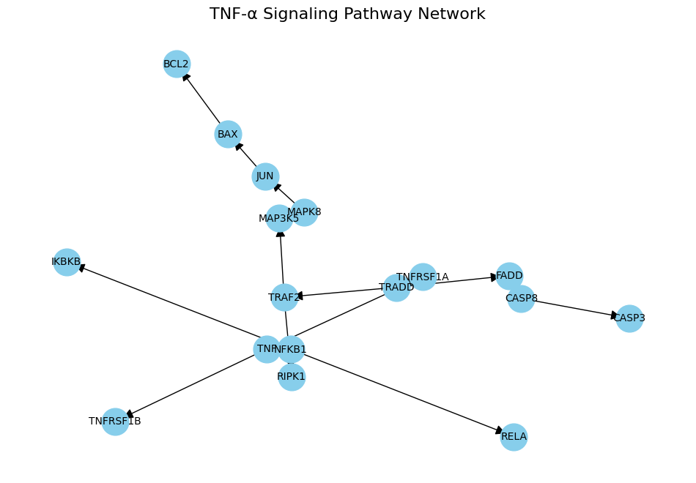
Results

Slide 9
Results
Centrality Analysis
Gene | Degree Centrality
TRADD | 0.31
TNFRSF1A | 0.25
FADD | 0.19
CASP8 | 0.19
NFKB1 | 0.19

Slide 10
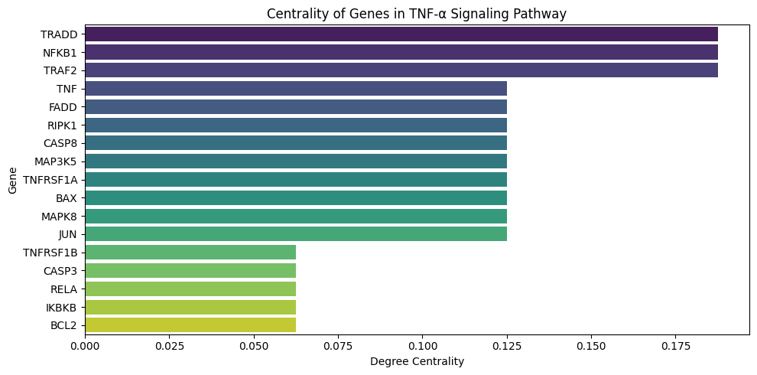
Results

Slide 11
Results
Gene Expression Visualization
Boxplots were generated for:
TNF: Upregulated in stimulated samples.
NFKB1: Moderately upregulated.
CASP8: Suggests early activation of the extrinsic apoptotic pathway.

Slide 12
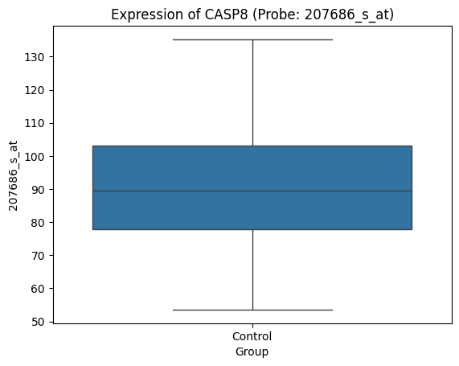
Results

Slide 13
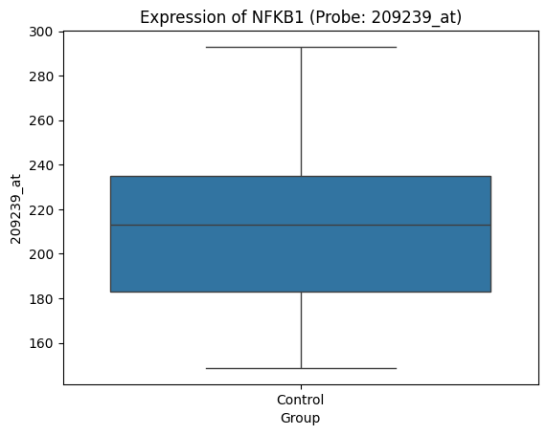
Results

Slide 14
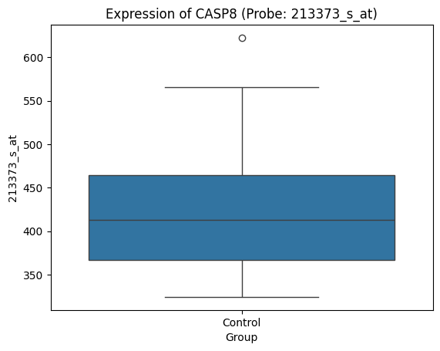
Results

Slide 15
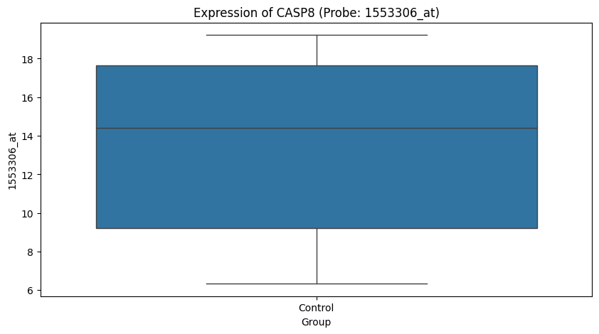
Results

Slide 16
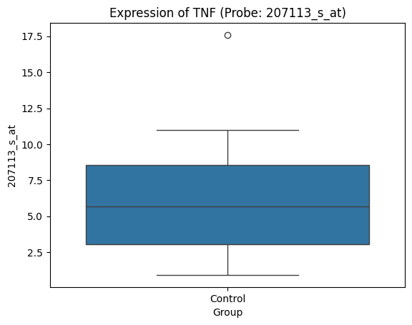
Results

Slide 17
Discussion
Bifurcation Behavior: TNF-α signaling can activate both
pro-survival (NF-κB, MAPK) and
pro-apoptotic (caspase) responses depending on intracellular context
and receptor dynamics.
TRADD and TRAF2 emerge as decision-making hubs,
directing the signaling cascade downstream.
Gene expression confirms expected pathway
activation post TNF-α stimulation.

Slide 18
Conclusion
Successfully modeled and visualized the TNF-α pathway.
Key nodes like TRADD, NFKB1, and CASP8 were highlighted
as influential in dictating pathway fate.
Differential expression patterns confirm the biological relevance of
the network structure.
This project demonstrates the value of integrating network biology and
gene expression analysis in unraveling complex cellular pathways.

Slide 19
Future Work
Incorporate dynamic modeling (ODEs or Boolean networks) to simulate
pathway responses over time.
Analyze additional TNF-α datasets (e.g., in cancer vs. autoimmune contexts).
Expand network with DrugBank/ChEMBL data to identify therapeutic targets.

Slide 20
References
Aggarwal, B.B. (2003). Signalling pathways of the TNF superfamily:
a double-edged sword.
Nature Reviews Immunology.
KEGG Pathway: hsa04668 — TNF Signaling.
GEO Database: GSE17307 – Gene expression in human fibroblasts
treated with TNF-α.
Biopython & GEOparse documentation.

